Slide 1


Evaluating Test-Suite Reduction in Real Software Evolution
August Shi, Alex Gyori, Suleman Mahmood,
Peiyuan Zhao, Darko Marinov
ISSTA 2018
Amsterdam, Netherlands
July 16, 2018
CCF-1409423
CCF-1421503
CNS-1646305

Slide 2
Regression Testing
test₁
test₂
test₃
test₄
…
test_{N-1}
test_{N}
Code Under Test
V₁
test₁
test₂
test₃
test₄
…
test_{N-1}
test_{N}
Code Under Test
V₂
test₁
test₂
test₃
test₄
…
test_{N-1}
test_{N}
Code Under Test
V₃
…
Many Tests x Many Versions = Costly!
Notes:
Regression testing is important, but slow
In regression testing, after every change, a developer has to run this large test suite to ensure the changes he/she made did not break any existing functionality.

Slide 3
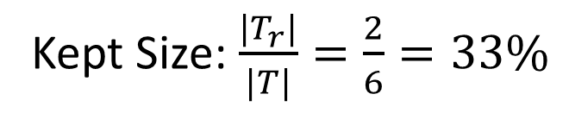
Test-Suite Reduction (TSR)
test₁
test₂
test₃
test₄
test₅
test₆
Code Under Test
V₁
test₁
test₂
test₃
test₄
test₅
test₆
Code Under Test
V₂
test₁
test₂
test₃
test₄
test₅
test₆
Code Under Test
V₃
Kept Size: $\frac{|T_{r}|}{|T|}=\frac{2}{6}=33\%$
Notes:
Test-suite reduction determines what tests are redundant and removes them on a revision, and then uses the reduced test suite for all future runs

Slide 4


Traditional Evaluation
test₁
test₂
test₃
test₄
test₅
test₆
Code Under Test
V₁’
Code Under Test
V₁’
Mutant 1
Mut 1
test₁
test₂
test₃
test₄
test₅
test₆
Code Under Test
V₁
Code Under Test
V₁
test₁
test₂
test₃
test₄
test₅
test₆
Code Under Test
V₁’’
Code Under Test
V₁’’
Mutant 2
Mut 2
Mutant 3
test₁
test₂
test₃
test₄
test₅
test₆
Code Under Test
V₁’’’
Code Under Test
V₁’’’
Code Under Test
V₁’’’
Coverage-based TSR
0% coverage loss
Mutant
Loss
All measured on single version!
Mut 3

Slide 5
How effective are reduced test suites at detecting faults in real software evolution?

Slide 6
Developer Usage of TSR
Missed test failure!
test₁
test₂
test₃
test₄
test₅
test₆
Code Under Test
V₁
test₁
test₂
test₃
test₄
test₅
test₆
Code Under Test
V₂
test₁
test₂
test₃
test₄
test₅
test₆
Code Under Test
V₃
Code Under Test
V₂
Miss-build
Miss-build?
Kept test failure, build fails
Detects same fault?
Notes:
Typically, people would start with a passing build/tests, and do reduction on those tests
The coverage-based TSR gives 0% coverage loss and small mutant loss, commonly measured in TSR research
What developer actually cares about is how effectiveness TSR is at detecting faults in future builds
Failed tests, leading to failed build

Slide 7
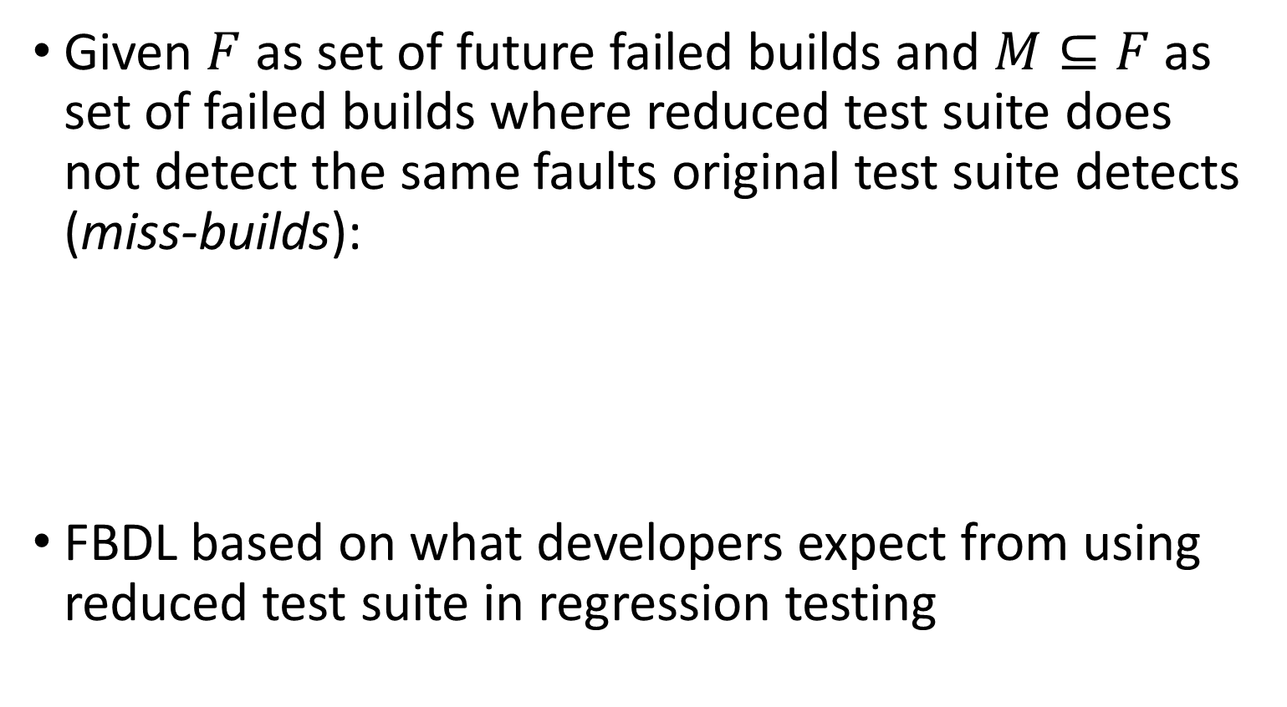

Failed-Build Detection Loss (FBDL)
Given $F$ as set of future failed builds and $M⊆F$ as set of failed builds where reduced test suite does not detect the same faults original test suite detects (miss-builds):
FBDL based on what developers expect from using reduced test suite in regression testing
$$FBDL=\frac{|M|}{|F|}$$
Notes:
To evaluate TSR effectiveness, we propose new metric based on future failed builds

Slide 8

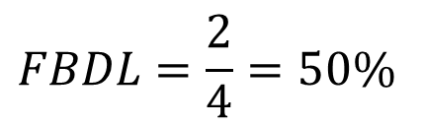


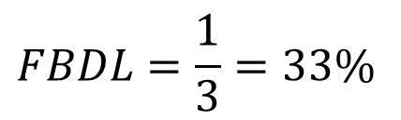

FBDL Example
$$|M|=2$$
$$FBDL=\frac{2}{4}=50\%$$
Reduction
Point
$$|F|=4$$
V₁
V₂
V₃
V₄
V₅
V₆
V₆
V₇
V₇
V₃
V₄
V₅
V₆
V₇
V₇
Reduction
Point
$$|M|=1$$
$$FBDL=\frac{1}{3}=33\%$$
$$|F|=3$$
Notes:
Green is passed build, Red is failed build

Slide 9
Miss-builds
When is a failed build a miss-build?
  Can developers find same faults using a subset of test failures?
Define miss-builds using heuristics for how likely groupings of failed tests are due to the same fault
  Parsing test failures from build logs

Slide 10
Classifying Failed Builds
Reduction
Point
V₁
V₂
V₃
V₄
V₅
V₆
V₆
V₇
Only new tests failed
All failed tests in reduced test suite
No failed test in reduced test suite
test₁
test₂
test₃
test₄
test₅
test₆
test₁
test₂
test₃
test₄
test₅
test₆
test₁
test₂
test₃
test₄
test₅
test₆
test₁
test₂
test₃
test₄
test₅
test₆
test₇
test₁
test₂
test₃
test₄
test₅
test₆
HIT
DEFMISS
NEWONLY

Slide 11
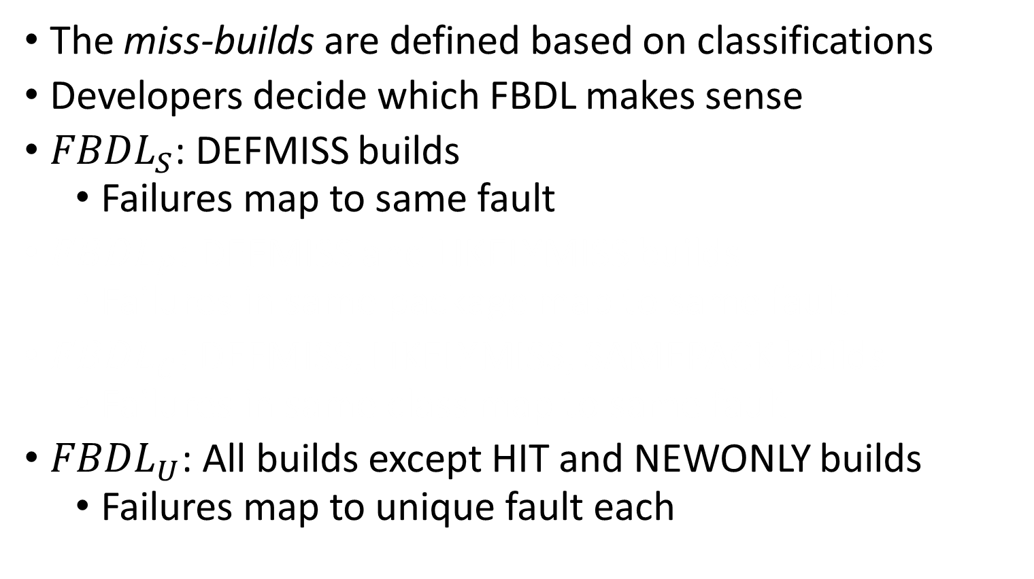
Classifying miss-builds for FBDL
The miss-builds are defined based on classifications
Developers decide which FBDL makes sense
${FBDL}_{S}$: DEFMISS builds
  Failures map to same fault
${FBDL}_{P}$: DEFMISS and LIKELYMISS builds
  Failures in same package map to same fault
${FBDL}_{C}$: DEFMISS, LIKELYMISS, SAMEPACK builds
  Failures in same class map to same fault
${FBDL}_{U}$: All builds except HIT and NEWONLY builds
  Failures map to unique fault each
?
Notes:
Miss-build is build where reduced test suite fails to detect all faults original test suite detects
These are the two extremes, but what about in between?

Slide 12
Classifying Failed Builds
Reduction
Point
V₁
V₂
V₃
V₄
V₅
V₆
Failed tests not in reduced test suite are in same test class as those kept
V₆
V₇
test₁
test₂
test₃
test₄
test₅
test₆
test₁
test₂
test₃
test₄
test₅
test₆
test₁
test₂
test₃
test₄
test₅
test₆
test₇
test₁
test₂
test₃
test₄
test₅
test₆
test₁
test₂
test₃
test₄
test₅
test₆
AT.test₁
AT.test₂
AT.test₃
BT.test₄
CT.test₅
CT.test₆
test₁
test₂
test₃
test₄
test₅
test₆
HIT
SAMECL
DEFMISS
NEWONLY
SAMEPKG: for tests in same package
LIKELYMISS: all remaining instances

Slide 13
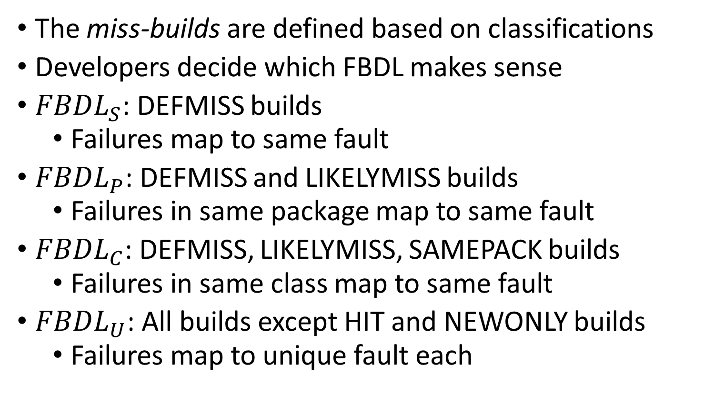
Classifying miss-builds for FBDL
The miss-builds are defined based on classifications
Developers decide which FBDL makes sense
${FBDL}_{S}$: DEFMISS builds
  Failures map to same fault
${FBDL}_{P}$: DEFMISS and LIKELYMISS builds
  Failures in same package map to same fault
${FBDL}_{C}$: DEFMISS, LIKELYMISS, SAMEPACK builds
  Failures in same class map to same fault
${FBDL}_{U}$: All builds except HIT and NEWONLY builds
  Failures map to unique fault each
Notes:
Miss-build is build where reduced test suite fails to detect all faults original test suite detects

Slide 14
Research Questions
RQ1: What is the FBDL of TSR?
RQ2: How well can the FBDL of TSR be predicted?
RQ3: How does distance from TSR reduction point affect FBDL?
See paper
Notes:
Only talk about first two RQs…

Slide 15
Evaluation
Failed builds, test failures taken from Travis CI
  32 projects, 1478 failed builds
  321 reduction points
Four TSR algorithms (GREEDY, GE, GRE, HGS)
Two types of test requirements (coverage, mutants)
Coverage-based TSR: 51.9% kept, 2.7% mutants loss
Mutant-based TSR: 61.1% kept, 2.2% coverage loss
Computed reductions match with prior work

Slide 16
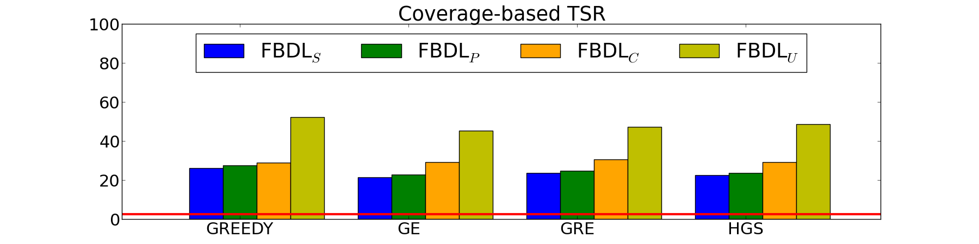
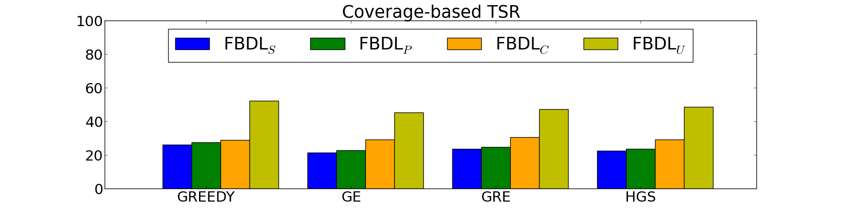
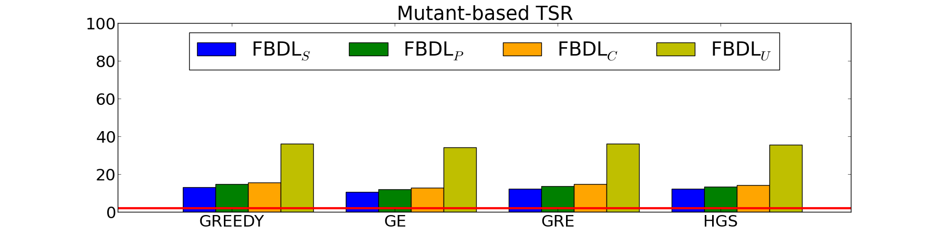
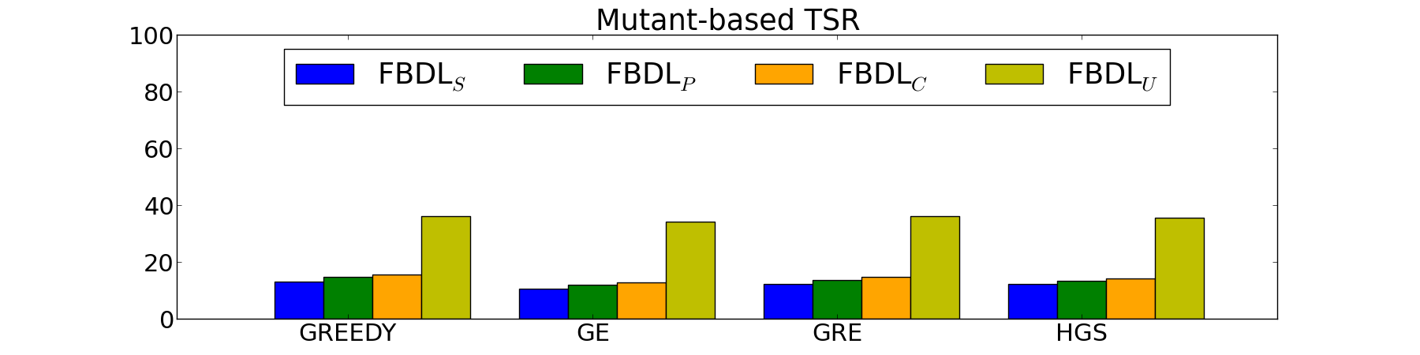
RQ1: FBDL of TSR
FBDL_{S} – failed tests to same fault
FBDL_{P} – same package failed tests to same fault
FBDL_{C} – same class failed tests to same fault
FBDL_{U} – failed tests to unique fault
Mut-Loss
Cov-Loss
Higher losses than suggested by traditional test-requirements loss
Notes:
Note that average values are very similar across different techniques, range from ~20% up to over 50% based on type of FBDL
With different test requirements to guide TSR, values are quite different
Overall, FBDL is much higher than suggested by commonly measured test requirements loss (~2%)

Slide 17
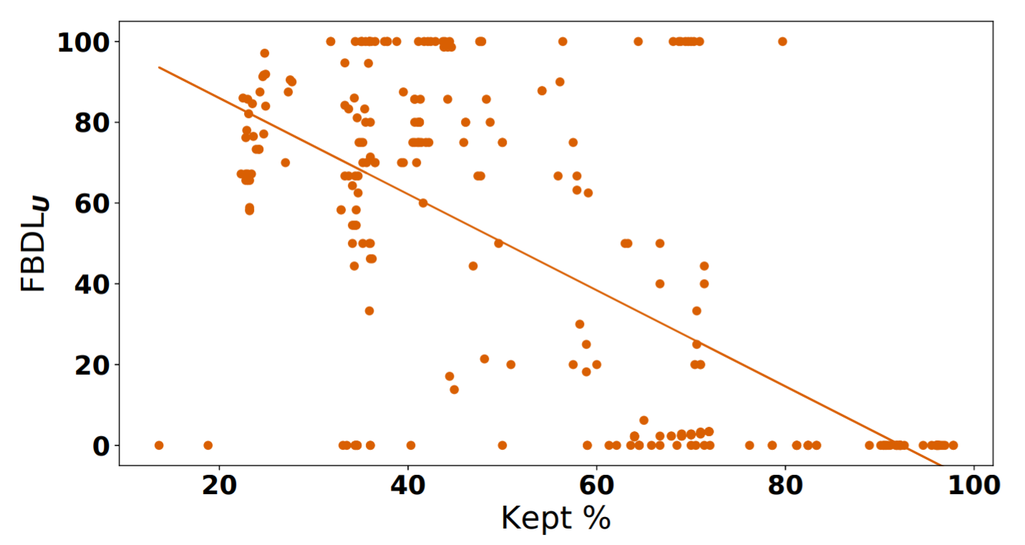

RQ2: Prediction of FBDL (Size)
How well does reduced test suite size predict FBDL?
  Intuition: the greater the kept percentage, the smaller the FBDL (keeping more failed tests)
$$R^{2}=0.45$$
$$τ_{b}=−0.41$$
Coverage-based GREEDY TSR
Notes:
Showing FBDL_U as it gets predicted the best out of all
Trend is correct, but stats not great

Slide 18
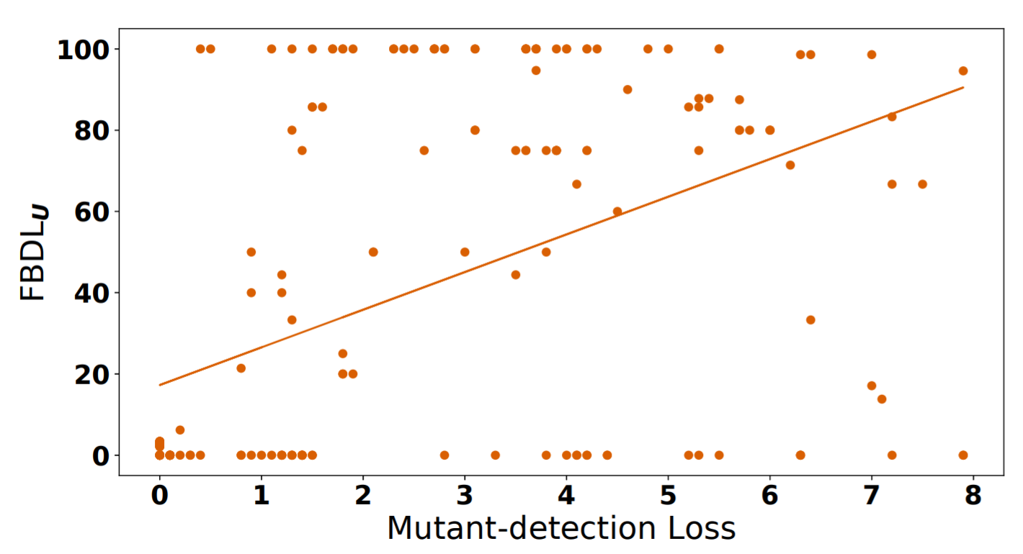

RQ2: Prediction of FBDL (Requirements)
How well does test-requirement loss predict FBDL?
  Intuition: the larger the loss in test-requirements, the worse the FBDL
$$R^{2}=0.25$$
$$τ_{b}=0.28$$
Coverage-based GREEDY TSR
Notes:
Showing FBDL_U as it gets predicted the best out of all
Trend is correct, but stats even worse

Slide 19
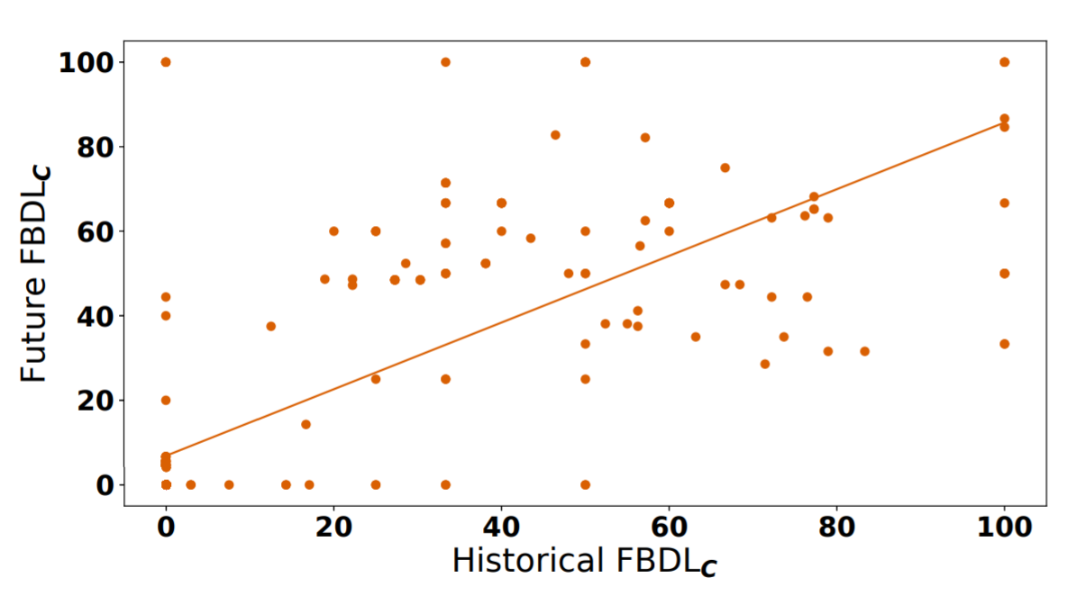

RQ2: Prediction of FBDL (History)
How well does historical FBDL predict future FBDL?
  Measure FBDL of a reduced test suite for first half of failed builds, then correlate with FBDL of second half
$$R^{2}=0.57$$
$$τ_{b}=0.64$$
Coverage-based GREEDY TSR
Notes:
Showing FBDL_C as it gets predicted the best out of all
Seems to be better, but still not great

Slide 20
Conclusions about TSR
Traditional
Evaluation
Our
Evaluation
Software Change
Mutants
Real evolution
# “Faults”
One at a time
Multiple faults
Evaluation Metric
Mutant-loss
FBDL (new)
Finding
TSR is effective
TSR is not effective,
and is risky/unpredictable
Research in TSR should evaluate with FBDL and improve FBDL,
or regression testing research should focus on techniques besides TSR
awshi2@illinois.edu
Notes:
We did not test for all algorithms, but for the ones we did evaluate are not encouraging for TSR. We encourage more research in TSR techniques, but they should be evaluated using FBDL

Slide 21
BACKUP

Slide 22
Lessons Learned
Parsing logs is difficult (Section 4.4)
  Getting test failures, matching test names
Matching test names across different versions and between tools is challenging (Section 4.4)
Rebuilding old versions of code is challenging
  Even reproducing passed builds is difficult! (Section 4.2)

Slide 23
RQ3: Distance from Reduction Point
Correlated distance from reduction point (in units of # builds) with FBDL
Create 10 bins of roughly equal sized number of builds, measured FBDL for each bin (based on number of failed builds there)
Found no correlation in FBDL versus distance

Slide 24
Threats to Validity
Generalization of results
  Evaluated four different algorithms, two different test-requirements
    Beyond these, should still evaluate with FBDL for better measurement of effectiveness
  Projects are Java, Maven-based from GitHub/Travis, as many that work with our tools
  Choice of reduction points provide diverse distances from failed builds to points
Inherently assumes no test-order dependencies
Inherently assumes build history does not change in simulation of TSR

Slide 25
Related Work
Our own prior work explored TSR in evolution
  Evaluation only looked at differences in test-requirements loss across different versions, suggesting loss does not change across versions

Slide 26
DELETED

Slide 27
How good are reduced test suites?
How effective at detecting the same faults the original test suite detects in future versions of code?
  Real evolution, real test failures
Can we predict effectiveness of reduced test suite?
  Even if reduced test suite can be not effective, can we at least predict when it can be useful?
  How good are traditional TSR metrics at predicting fault-detection effectiveness in future?
Notes:
NOTE: Add RQs (reworded) right after this?

Slide 28
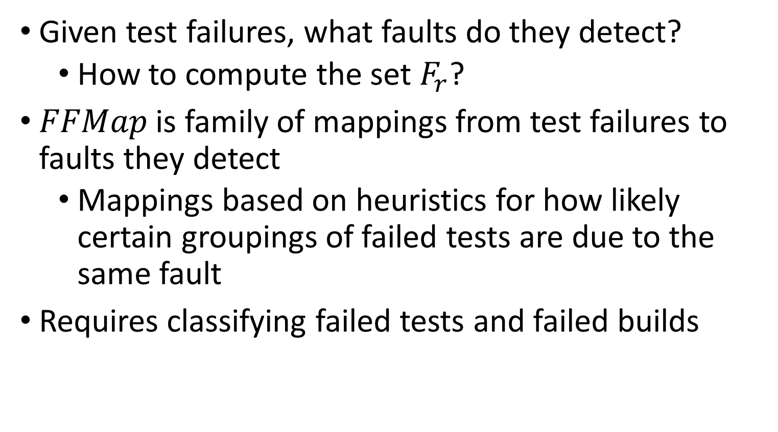
Failure-to-Fault Map
Given test failures, what faults do they detect?
  How to compute the set $F_{r}$?
$FFMap$ is family of mappings from test failures to faults they detect
  Mappings based on heuristics for how likely certain groupings of failed tests are due to the same fault
Requires classifying failed tests and failed builds

Slide 29
Classifying Failed Tests
Failed tests in future builds classified w.r.t. reduced test suite computed at prior reduction point
KEPT: Failed test exists in reduced test suite
REMOVED: Failed test was removed from reduced test suite
NEW: Failed test did not exist at reduction point

Slide 30
Classifying Failed Tests
Failed tests in future builds classified w.r.t. reduced test suite
KEPT
Original
Reduced
test₀
test₁
test₂
test₃
test₄
test₀
test₁
test₂
test₃
test₄
test₀
test₁
test₂
test₃
test₄
test₅
REMOVED
NEW
V₁
V₂ (failed)

Slide 31
Classifying Failed Builds
Failed builds are classified based on failed tests
DEFMISS: All failed tests are REMOVED
HIT: No failed tests are REMOVED, at least one KEPT
NEWONLY: All failed tests are NEW
SAMECL: All REMOVED tests are in same class as KEPT/NEW ones
SAMEPACK: All REMOVED tests are in same package as KEPT/NEW ones
LIKELYMISS: All remaining failed builds

Slide 32
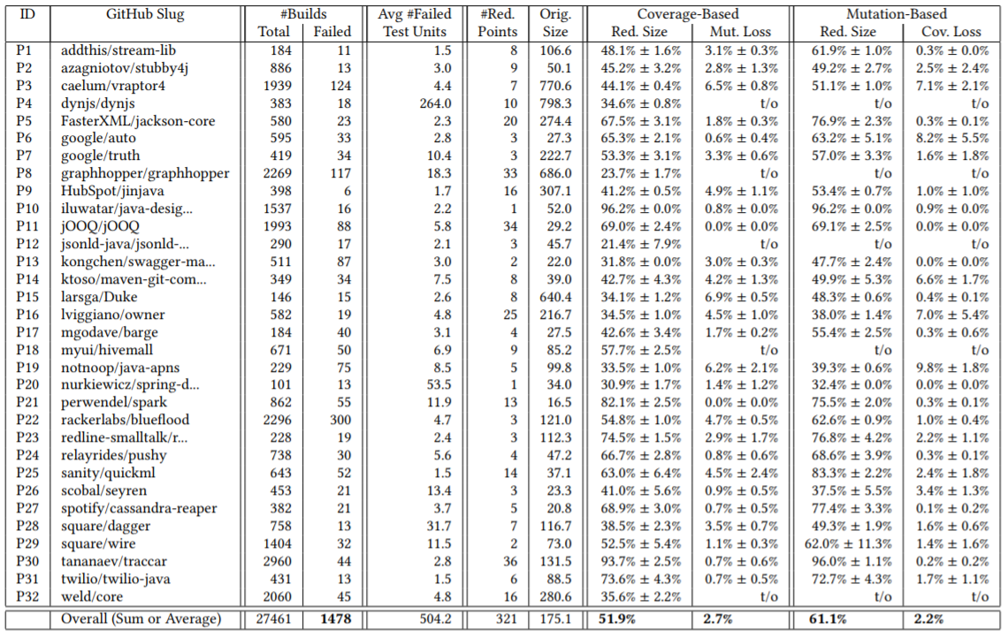
Basic TSR Stats
Notes:
Table too much? Any need to show?

Slide 33
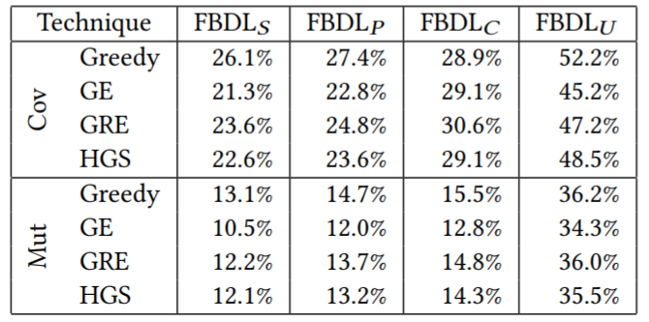
RQ1: FBDL of TSR
Mut Loss:
2.7%
Cov Loss:
2.2%
Higher losses than suggested by traditional test-requirements loss
Notes:
Note that average values are very similar across different techniques, range from ~20% up to over 50% based on type of FBDL
With different test requirements to guide TSR, values are quite different
Overall, FBDL is much higher than suggested by commonly measured test-requirement loss (~2%)

Slide 34
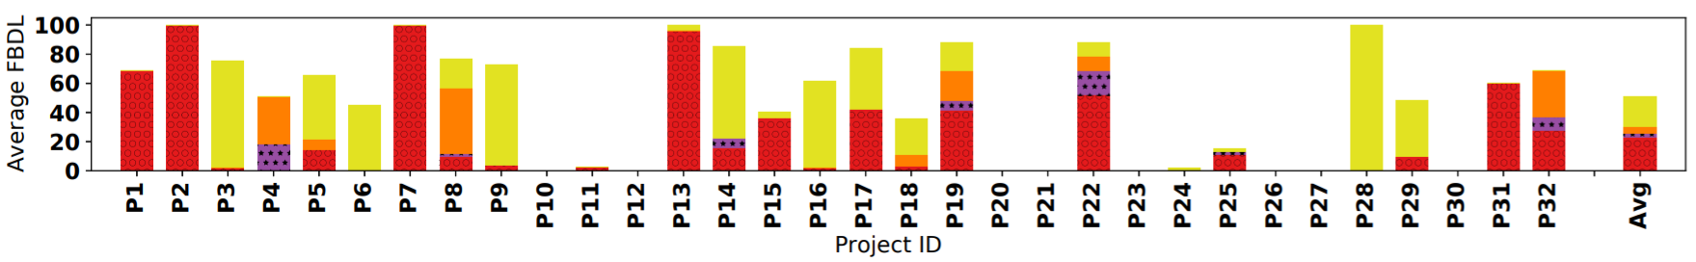

RQ1: FBDL of TSR
FBDL for Greedy, coverage-based TSR
Average, 9.5% for ${FBDL}_{S}$ and 52.2% for ${FBDL}_{U}$
$FBDL$ is much higher than suggested by mutant loss
Notes:
Show this picture? Is it necessary? Does it make sense?

